Slide 1
Intro to Crypto and Cryptocurrencies
Slides by Arvind Narayanan et al.

Slide 2
Mining hardware

Slide 3
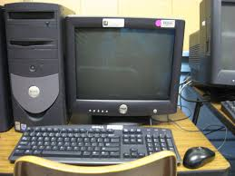
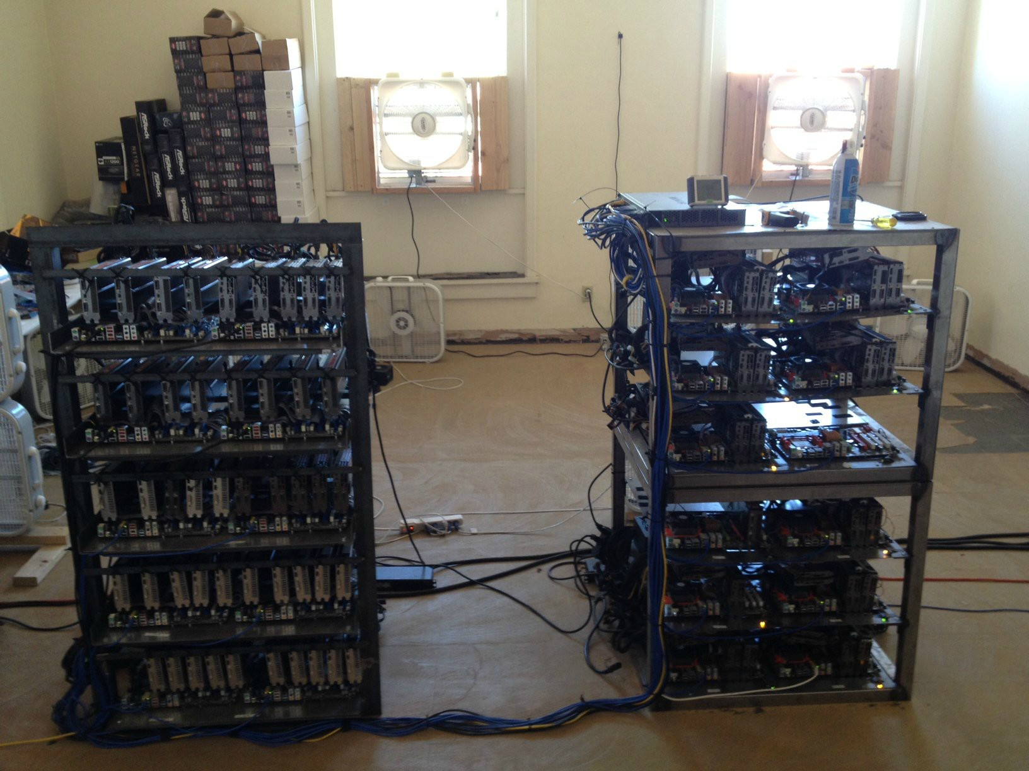
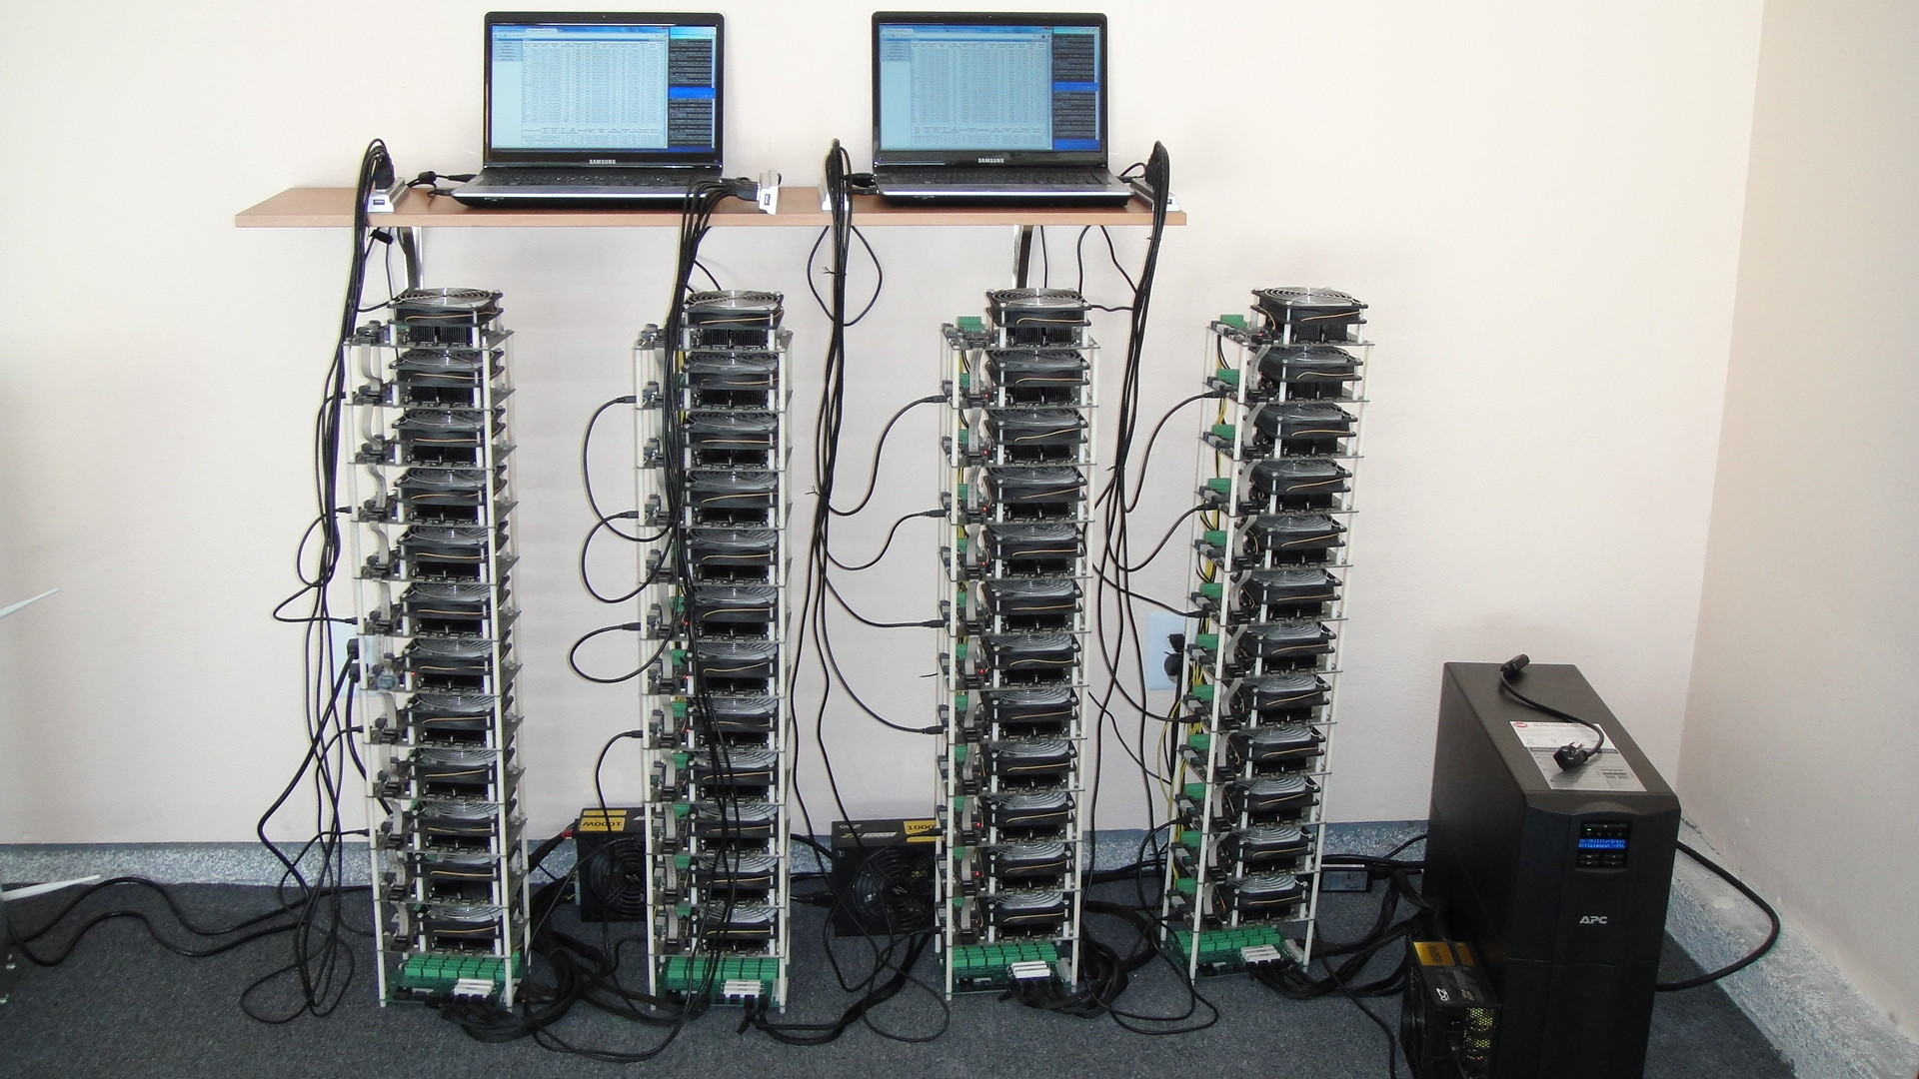
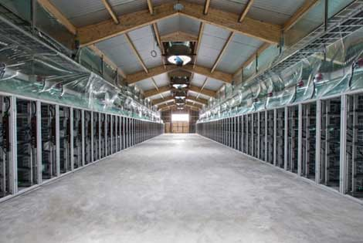
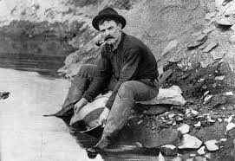
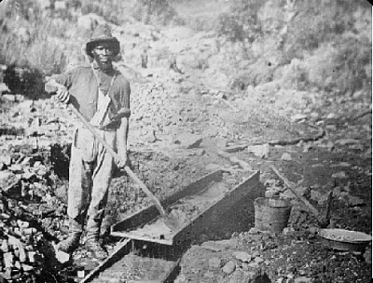
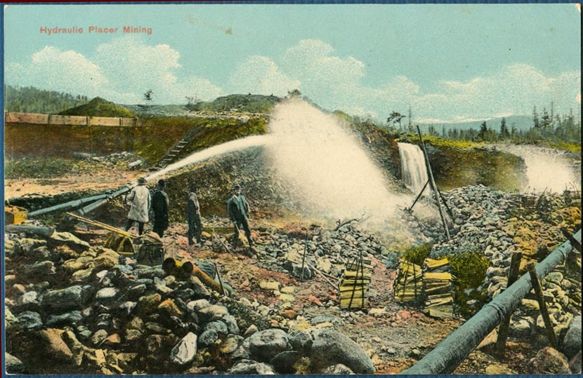
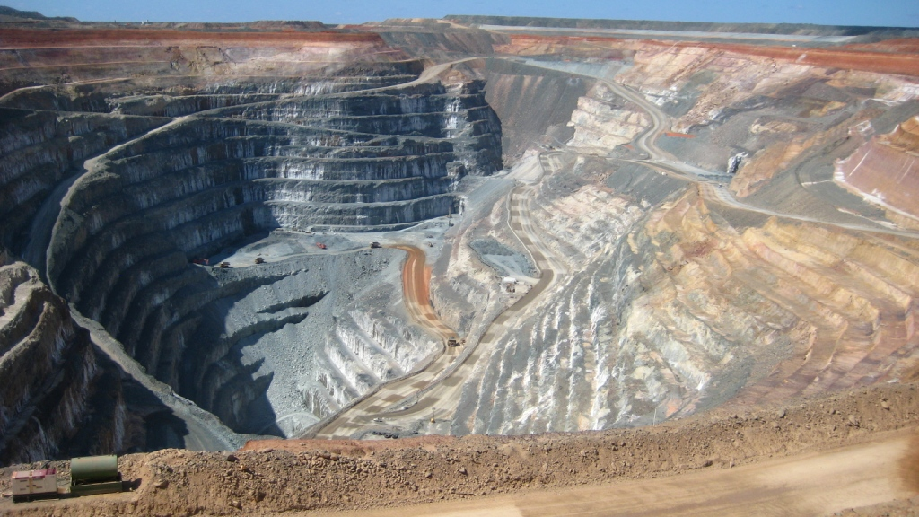
Evolution of mining
CPU GPU FPGA ASIC
gold pan sluice box placer mining pit mining

Slide 4
Energy consumption & ecology

Slide 5
Thermodynamic limits
Landauer’s principle: Any non-reversible computation must consume a minimum amount of energy.
Specifically, each bit changed requires (kT ln 2) joules.
K is Boltzman Constant and T is the Temperature of the circuit in kelvins
SHA-256 is not reversible
Energy consumption is inevitable

Slide 6
Energy aspects of Bitcoin mining
Embodied energy: used to manufacture mining chips & other equipment
should decrease over time
Electricity: used to perform computation
should increase over time
Cooling: required to protect equipment
costs more with increased scale!

Slide 7
Estimating energy usage: top-down
Each block worth approximately US$6,500
Approximately $11/s generated
Industrial electricity (US): $0.03/megajoule or $0.10/kilowatt-hour
Upper bound on electricity consumed:
367 MJ/s = 367 MW
1 watt (power)=1 joule/s (energy)

Slide 8
Estimating energy usage: bottom-up
Best claimed efficiency: 1 gigahashes/sec/watt
Network hash rate: 150,000,000 gigahashes/sec (excludes cooling, embodied energy)
Lower bound on electricity consumed:
150 MW

Slide 9
Mining pools

Slide 10

Economics of being a small miner
Cost: ≈US$6,000
Expected time to find a block: ≈14 months
Expected revenue: ≈$1,000/month
TerraMiner IV

Slide 11
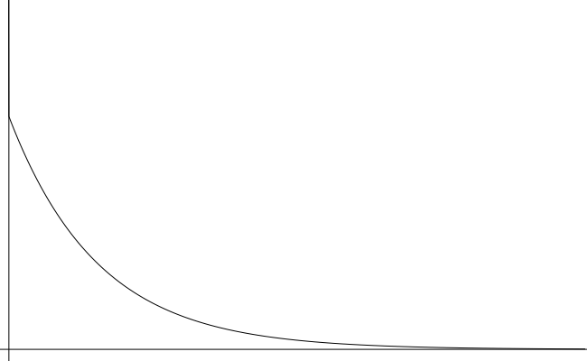

Mining uncertainty
# blocks found in one year | probability (Poisson dist.)
0 | 42.4%
1 | 36.4%
2 | 15.6%
3+ | 5.6%
14
months
Probability density
Time to find first block

Slide 12
Mining pools
Goal: pool participants all attempt to mine a block with the same coinbase recipient
send money to key owned by pool manager
Distribute revenues to members based on how much work they have performed
minus a cut for pool manager
How do we know how much work members perform?

Slide 13
Mining shares
Idea: prove work with “near-valid blocks” (shares)
4AA087F0A52ED2093FA816E53B9B6317F9B8C1227A61F9481AFED67301F2E3FB
D3E51477DCAB108750A5BC9093F6510759CC880BB171A5B77FB4A34ACA27DEDD
00000000008534FF68B98935D090DF5669E3403BD16F1CDFD41CF17D6B474255
BB34ECA3DBB52EFF4B104EBBC0974841EF2F3A59EBBC4474A12F9F595EB81F4B
00000000002F891C1E232F687E41515637F7699EA0F462C2564233FE082BB0AF
0090488133779E7E98177AF1C765CF02D01AB4848DF555533B6C4CFCA201CBA1
460BEFA43B7083E502D36D9D08D64AFB99A100B3B80D4EA4F7B38E18174A0BFB
000000000000000078FB7E1F7E2E4854B8BC71412197EB1448911FA77BAE808A
652F374601D149AC47E01E7776138456181FA4F9D0EEDD8C4FDE3BEF6B1B7ECE
785526402143A291CFD60DA09CC80DD066BC723FD5FD20F9B50D614313529AF3
000000000041EE593434686000AF77F54CDE839A6CE30957B14EDEC10B15C9E5
9C20B06B01A0136F192BD48E0F372A4B9E6BA6ABC36F02FCED22FD9780026A8F

Slide 14
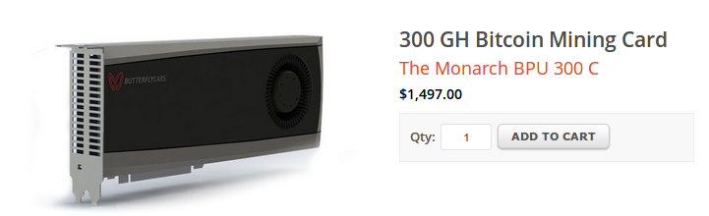
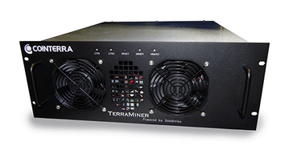
Mining pools
Hey folks! Here’s our next block to work on
Pool manager
prev: H( )
mrkl_root: H( )
coinbase:
25→pool
$$$
nonce:
hash:
$$
0x00000000000a877902e...
$
0x000000000001e8709ce...
0x00000000000000003f89...
0x00000000000490c6b00...
0x0000000000007313f89...
0x0000000000045a1611f...

Slide 15
Mining pool variations
Pay per share: flat reward per share
Typically minus a significant fee
What if miners never send valid blocks?
Proportional: typically since last block
Lower risk for pool manager
More work to verify and distribute rewards
Many others….

Slide 16
Mining pool protocols
API for fetching blocks, submitting shares
Stratum
Getwork
Getblockshare
Proposed for standardization with a BIP (Bitcoin Improvement Proposal)
Increasingly important; some hardware support

Slide 17
Mining pool history
First pools appear in late-2010
Back in the GPU era!
By 2014: around 90% of mining pool-based
June 2014: GHash.io exceeds 50%

Slide 18
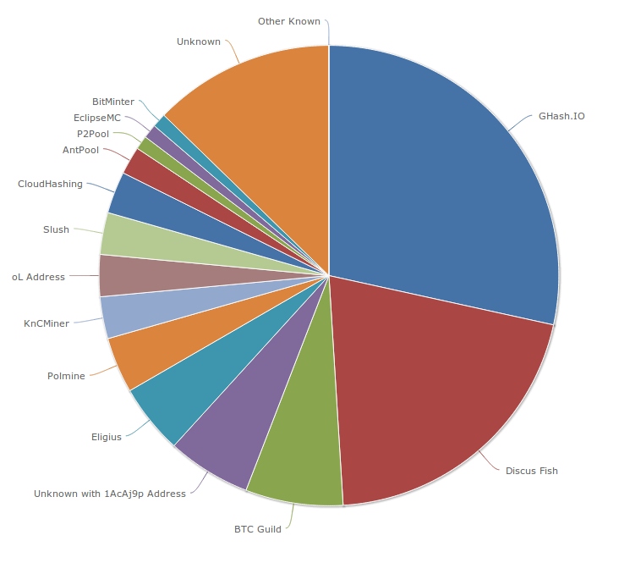
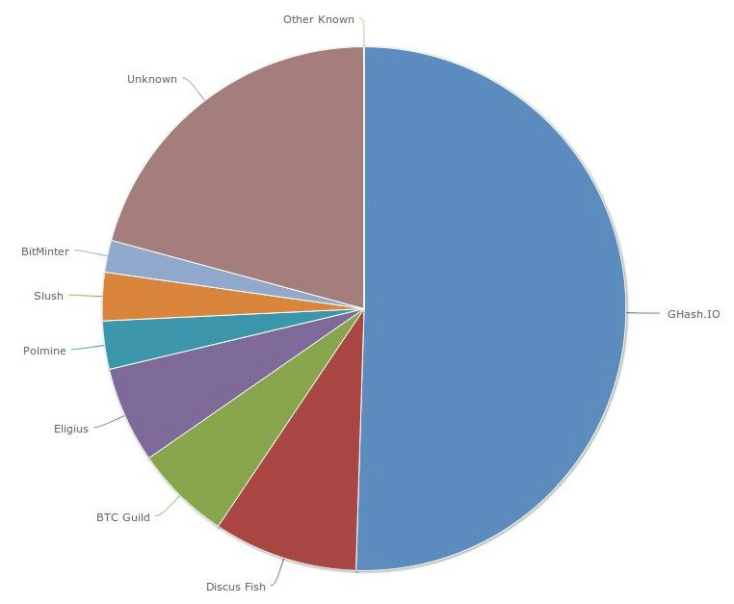
Mining pools Hash Power (as of June 2014,August 2014)

Slide 19
Are mining pools a good thing?
Pros
Make mining more predictable
Allow small miners to participate
More miners using updated validation software
Cons
Lead to centralization
Discourage miners from running full nodes (offload the validation tasks to pool mangrs)

Slide 20
Mining incentives and strategies

Slide 21
Game-theoretic analysis of mining
Several strategic decisions
Which transactions to include in a block
Default: any above minimum transaction fee
Which block to mine on top of
Default: longest valid chain
How to choose between colliding blocks
Default: first block heard
When to announce new blocks
Default: immediately after finding them

Slide 22
Game-theoretic analysis of mining
Assume you control 0 < α < 1 of mining power
Can you profit from a non-default strategy?
For some α, YES, though analysis is ongoing!

Slide 23
Forking attacks
M→M’
M→M’
M→B
M→B

Slide 24
Forking attacks
Certainly possible if α >0.5
may be possible with less
avoid block collisions
Attack is detectable
Might be reversed
Might crash exchange rate

Slide 25
Forking attacks via bribery
Idea: building α > 0.5 is expensive. Why not rent it instead?
Payment techniques:
Out-of-band bribery
Run a mining pool at a loss
Insert large “tips” in the block chain
This is an open problem!

Slide 26
Block-withholding attacks
Strategy: don’t announce blocks right away. Try to get ahead!
“Selfish mining”
Secret Block
Secret Block
All other miners are wasting effort here!

Slide 27

Block-withholding attacks, take 2
What happens if a block is announced when you’re ahead by 1?
Secret Block
The race is on!

Slide 28
Block-withholding attacks
Improved strategy for any α if you can win every race
Ideal network position
Bribery?
With a 50% chance of winning races, improved strategy for α > 0.25
Not yet observed in practice!
Surprising departure from previous assumptions

